Slide 1
Analysis of Representations for Domain Adaptation
分享人：罗宏涛 2020.11.24

Slide 2
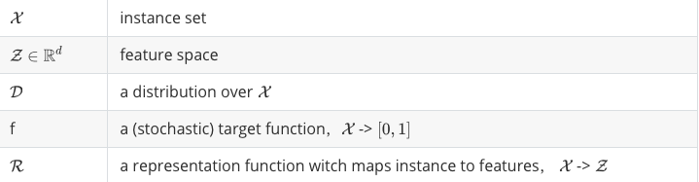
Notations

Slide 3


Notations

Slide 4
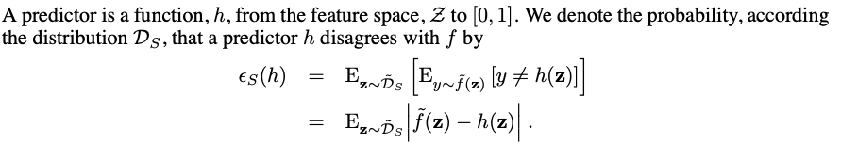
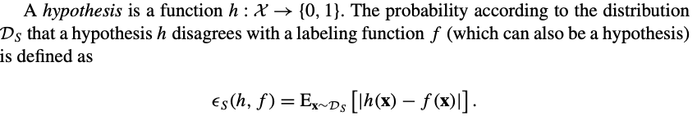
Domain Adaptation
Ben-David et al. 2006
Ben-David et al. 2010

Slide 5
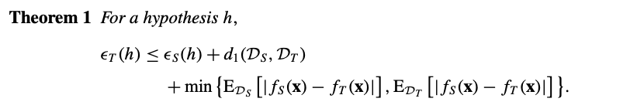



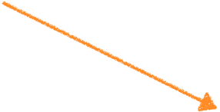
A bound relating the source and target error
Source risk
Distance between domains
Distance between label functions

Slide 6
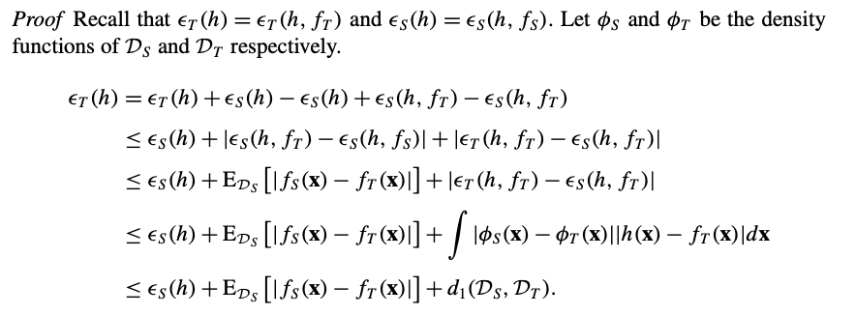




A bound relating the source and target error

Slide 7




A-distance
H-distance
Under limitation
Replace A with

Slide 8
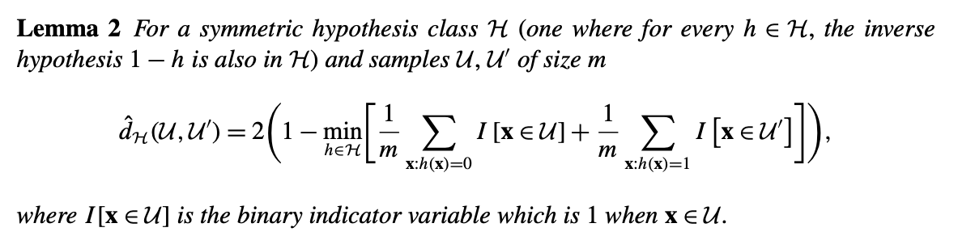
Bound on the target domain error

Slide 9
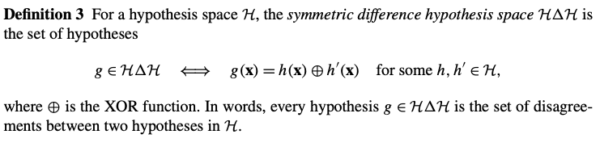
Bound on the target domain error

Slide 10
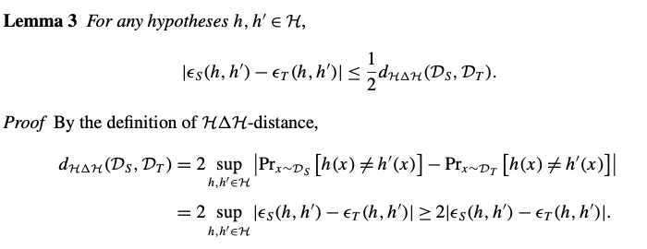
Bound on the target domain error

Slide 11
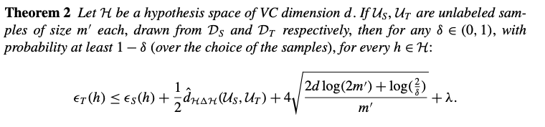
Bound on the target domain error

Slide 12
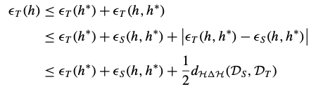
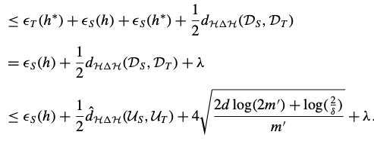
Bound on the target domain error

